Slide 1
UCB - CS189 Introduction to Machine Learning Fall 2015 Lecture 12: Gaussian classifier
Isabelle Guyon
ChaLearn

Slide 2
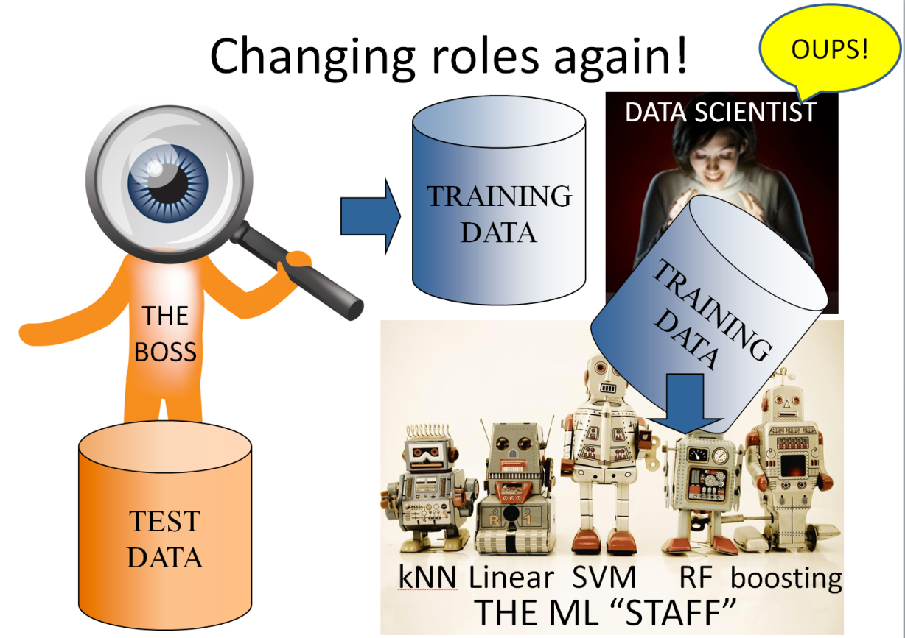
Come to my office hours… Wed 2:30-4:30 Soda 329
Last time: embedded methods

Slide 3
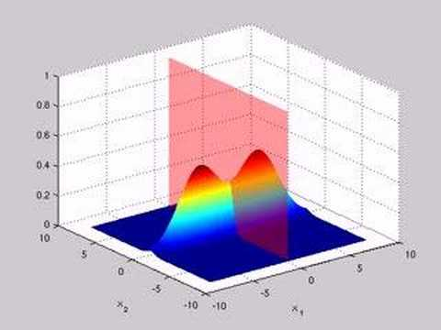
Come to my office hours… Wed 2:30-4:30 Soda 329
Today: Gaussian classifier aka centroid method aka naïve Bayes aka Hebb’s rule revised

Slide 4
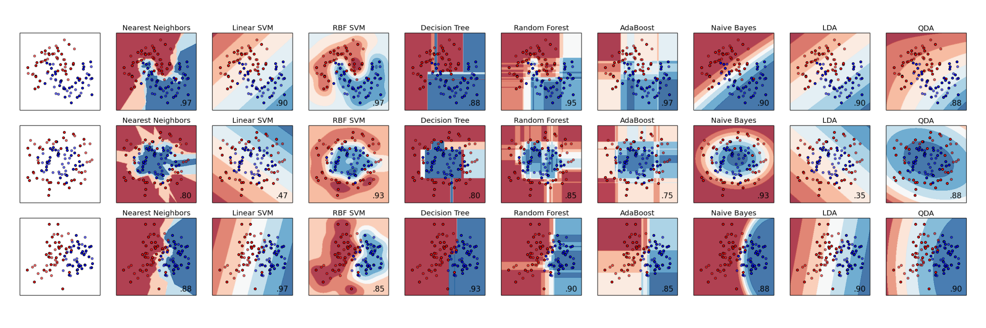
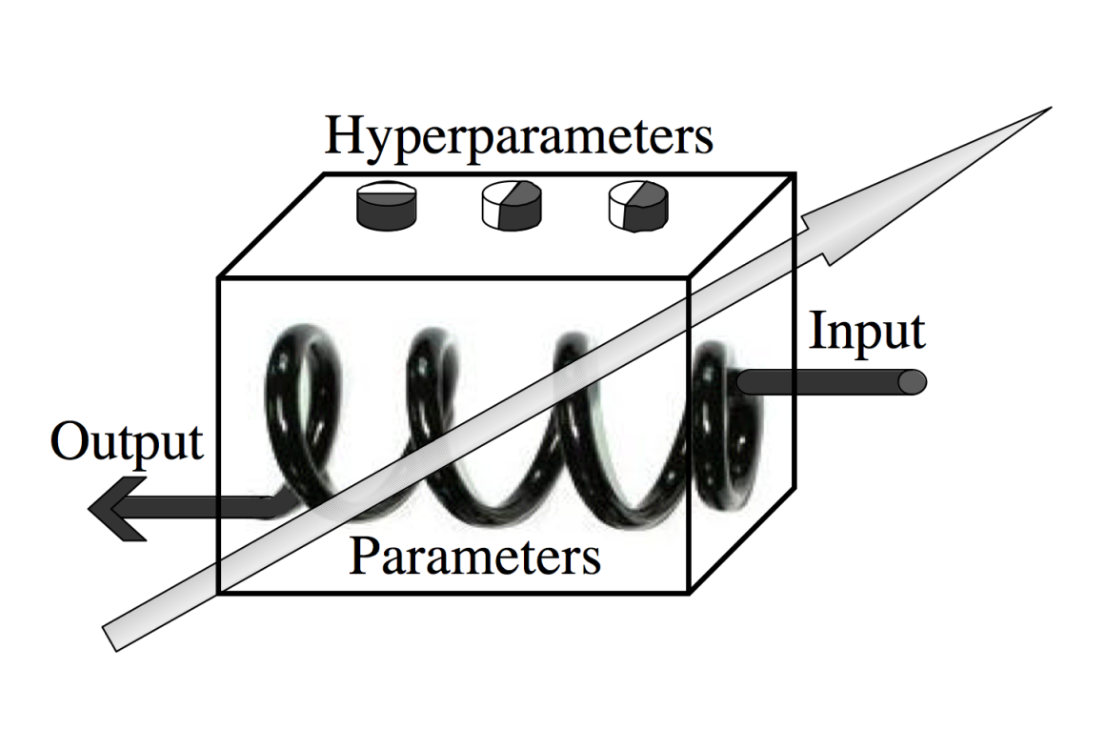

State of the art ML toolkits
Review
Source: Scikit Learn http://scikit-learn.org/stable/auto_examples/classification/plot_classifier_comparison.html
y
Output
f(x)
Input
x
Loss
L(f(x), y)
kNN Linear SVM RF boosting
THE ML “STAFF”
- η ∇_{w}L

Slide 5


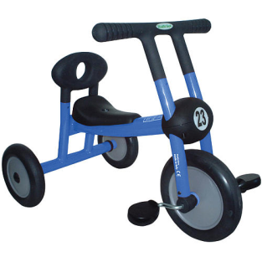

Perceptrons and kernel methods f(x) = ( Σ_{k} α_{k} [Φ(x^{k}) ) • Φ(x) ]
Review
w
k(x^{k}, x; θ)
Parzen windows
α_{k =} y_{k}
Any k(x^{k}, x; θ)
θ fitted to R_{CV}
f(x)=Σ_{k} α_{k} k(x^{k}, x ; θ)
Perceptrons
α_{k} fitted to R_{train}
k(x^{k}, x) = x^{k} • x
No θ
f(x) = w • x
Kernel methods
α_{k} fitted to R_{train}
Any k(x^{k}, x; θ)
θ fitted to R_{CV}
f(x)=Σ_{k} α_{k} k(x^{k}, x ; θ)
Hebb’s method
α_{k =} y_{k}
k(x^{k}, x) = x^{k} • x
No θ
f(x) = w • x

Slide 6
Training
Review
We do not want to just minimize:
R_{train}[f] = (1/N) Σ_{k=1:N} L( f(x^{k}), y^{k} )
We want to get best “generalization” (test error on future example).
So we minimize R_{reg}[f] = R_{train}[f] + λ Ω[f]
Ω[f] = ǁwǁ² is a “regularizer”.
Learning can be performed by gradient descent:
Δw_{total} = - η ∇_{w}R – γ w (Total gradient) (γ =2 η λ)
Δw_{stoc} = - η ∇_{w}L – γ w (Stochastic gradient)
Linear model: f(x) = w.Φ(x) ; ∇_{w}f = Φ(x)
Chain rule: ∂L/∂w_{i} = ∂L/∂f ∂f/∂w_{i} or ∇_{w}L = ∂L/∂f ∇_{w}f
Δw_{stoc} = - η ∂L/∂f Φ(x) – γ w
Δw_{stoc}(x^{k}) = - η ∂L/∂f|_{(xk, yk)} Φ(x^{k}) – γ w for example k
Total gradient:
Δw_{total} = (1/N) Σ_{k=1:N} Δw_{stoc}(x^{k})
Kernel trick: f(x) = Σ_{k} α_{k} k(x^{k}, x) = Σ_{k} α_{k} Φ(x^{k}).Φ(x) ; w = Σ_{k} α_{k} Φ(x^{k}).
Δα_{k} = - η ∂L/∂f|_{(xk, yk)} - γ α_{k} stochastic gradient, for example k
Δα_{h} = - γ α_{h} stochastic gradient, for other examples

Slide 7

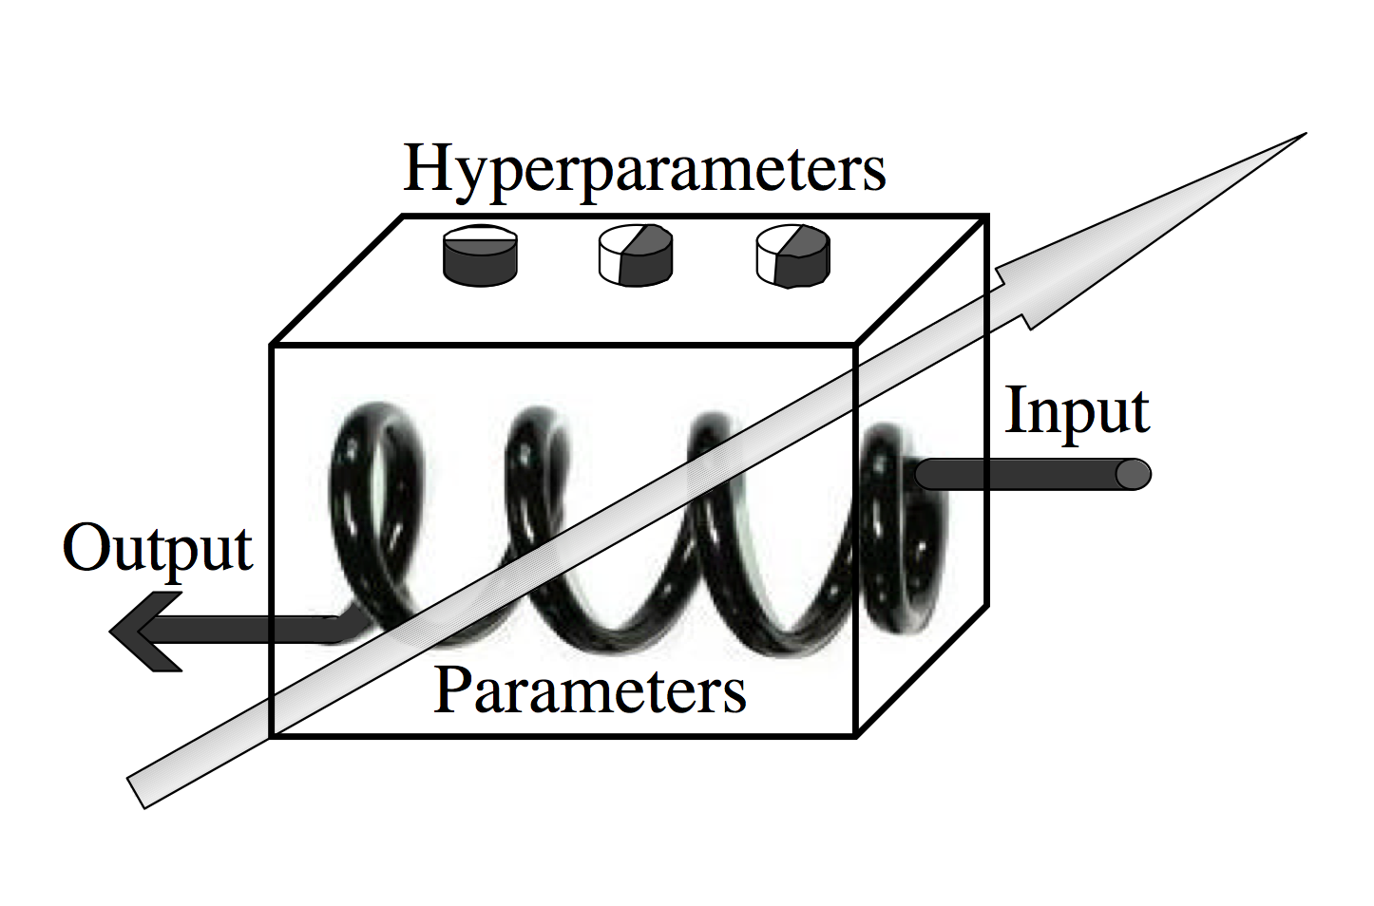
Model selection / hyper-parameter search
Review
DATA SCIENTIST
Output
Input

Slide 8
Model selection / hyper-parameter search
Review
DATA SCIENTIST
TEST
DATA
Validation
set
Training
set

Slide 9
Wrappers don’t scale well
Review
θ
Output
Input
D=dim(θ), g=number of values of θ_{i}, K-fold CV evaluation: Kg^{D} boxes to train!
D=10, g=10, K=10: Kg^{D}=10¹¹

Slide 10

Kg^{D}=10¹¹ boxes to train! Combine search strategies:
Review
1) Filters
3) Wrappers
2) Embedded
methods
D=10 → D=4 → D=2
No training 1for λ x 10 for θ = 10 Kg^{D}=10*10²=1000

Slide 11



The actors of machine learning
P(X, Y)
TRAINING
DATA
ORACLE
DATA SCIENTIST
ORACLE
Validation
set
Training
set
THE
BOSS
I.I.D. examples (x₁, y₁), (x₂, y₂), …
TEST
DATA
THE ML “STAFF”

Slide 12

What does the Oracle have to say?
Anxiety
Peer Pressure
Born an
Even Day
Yellow
Fingers
Smoking
Genetics
Allergy
Lung Cancer
Attention
Disorder
Coughing
Fatigue
Car Accident
This is y (the rest are x_{i})

Slide 13

But, here we consider only P(X, Y) = P(X)P(Y|X) = P(Y)P(X|Y)
Peer Pressure
Peer Pressure
Car Accident
Car Accident
Anxiety
Anxiety
P(X|Y)
P(X)
Yellow
Fingers
Yellow
Fingers
P(Y|X)
Lung Cancer
Smoking
Smoking
Y=y
Allergy
Lung Cancer
P(Y)
Allergy
Coughing
Y=y
Coughing
Fatigue
Fatigue
Attention
Disorder
Attention
Disorder
Born an
Even Day
Born an
Even Day
Genetics
Genetics
X=x
X=x

Slide 14
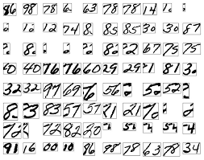



But, here we consider only P(X, Y) = P(X)P(Y|X) = P(Y)P(X|Y)
P(X)
5
P(Y)
P(X|Y)
P(Y|X)
96 98 78 6 63 79…

Slide 15
What is the data generating process?
x₂
x₁

Slide 16
There can be a common cause y
x₂
y
x₁
x₁ | x₂ | y

Slide 17
There can be a common cause y
y = gender
x₂ = life length
Female
y
Chocolate
Life length
Male
x₁ = chocolate intake
x₁ | x₂ | y

Slide 18
What is the data generating process?
x₂
x₁
x₁ | x₂

Slide 19
y must be a consequence
y
x₂
x₁
x₁ | x₂

Slide 20
y must be a consequence
y = >50K salary
y = (>50K salary)
x₂
Age
Age
Highest degree
x₁ = Highest degree
x₁ | x₂

Slide 21


So: we have 2 cases:
x₂
x₂
y
P(Y)
x₁
P(X)
P(Y|X)
x₁
P(X|Y)

Slide 22
Consider the first case
y drawn at random determines the centroid.
x = centroid + random “noise”.
x₂
x₂
y
P(Y=y)
x₁
x₁
P(X=x|Y=y)

Slide 23
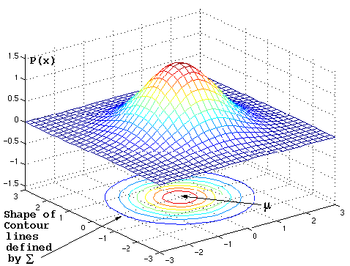
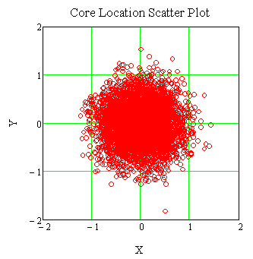
The easiest is to assume isotropic Gaussian noise ~exp(-ǁx-μǁ²/2σ²)
Source: https://www.byclb.com/TR/Tutorials/neural_networks/ch4_1.htm

Slide 24
So we get the Gaussian classifier
Bayes optimal classifier: Classify x in class y according to the largest P(Y=y|X=x).
Bayes rule: P(X, Y) = P(X)P(Y|X) = P(Y)P(X|Y).
So P(Y=y|X=x) ~ P(Y=y) P(X=x|Y=y) .
Prior = class relative abundance:
P(Y=1)≈N₁/N. P(Y=-1)≈N₀/N.
Likelihood = Proba x belongs to class y, proportional to exp(-ǁx-μ^{[y]}ǁ²/2σ²).
Posterior
Prior
Likelihood

Slide 25
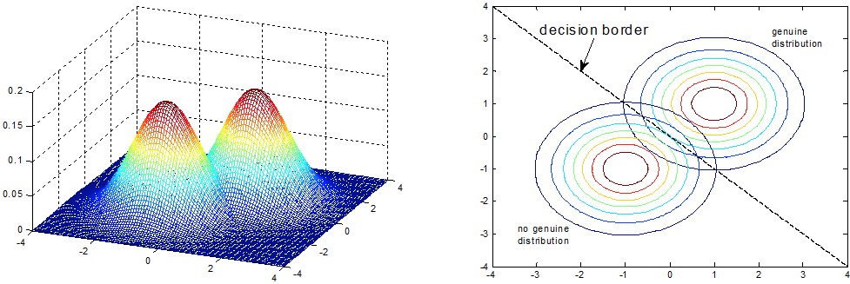
No sweat: this is a linear classifier!
Source: http://www.intechopen.com/source/html/17742/media/image25.png
f(x) =0
f(x) = (μ^{[1]} – μ^{[0]}) • x + b b = (μ^{[0]2} – μ^{[1]2})/2+log(N₁/N₀)
w

Slide 26






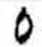

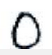

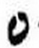
Does this remind you of something? The “centroids” method (also called “template matching”)!
x₂ = shape_elongation
μ^{[1]}
x₁ = amount_ink
μ^{[0]}
0
Just average the vectors of each class.
You get vectors representing average shapes.

Slide 27
Lecture #2: separate “0” and “1”: get the separaring “hyperplane”
w=μ^{[1]}-μ^{[0]}
x₂ = shape_elongation
f(x) < 0
x₁ = amount_ink
0
f(x) > 0
f(x) = w.x = 0

Slide 28
So: Gaussian classifier = centroid method
This is a VERY useful method.
The assumptions are:
Generating model: draw y first, then draw x given y.
Gaussian “noise”.
Independence of the features in a given class (no covariance).
Same σ for all classes.
This NOT the optimum Bayes classifier (even though it uses Bayes rule), because:
The assumptions are almost always violated.
We estimate μ^{[1]} and μ^{[0]} from a finite number of examples.
Now we know how to compute the bias
b = (μ^{[0]2} – μ^{[1]2})/2+log(N₁/N₀), but who cares?

Slide 29
We do not care about “b” because we “post fit it”
For a given threshold on f(x), you get a point on the ROC curve.
Ideal ROC curve
100%
x₂
f(x) < 0
Actual ROC
HITS
f(x) = -1
Positive class success rate
(hit rate, sensitivity)
f(x) = 0
f(x) = 1
Random ROC
0
100%
f(x) > 0
FALSE ALARMS
x₁
1 - negative class success rate (false alarm rate, 1-specificity)
Notes:
Explain that this is a global estimator

Slide 30
Link with Hebb’s rule…
Class centroids:
μ^{[0]} = (1/N₀) ∑_{{y=-1}} x^{k}
μ^{[1]} = (1/N₁) ∑_{{y=+1}} x^{k}
Weight vector:
w = μ^{[1]} - μ^{[0]} = ∑_{k} y^{k} x^{k}
y^{k} = 1/N₁ if x^{k} belongs class 1,
y^{k} = -1/N₀ otherwise.
So this is Hebb’s rule with “rebalanced” target values.
It can trivially be “kernelized” with α^{k} = y^{k} using the linear kernel k(x, x’) = x • x’

Slide 31
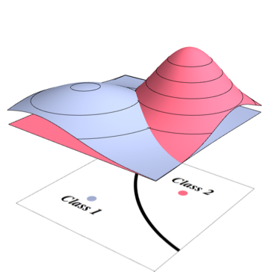
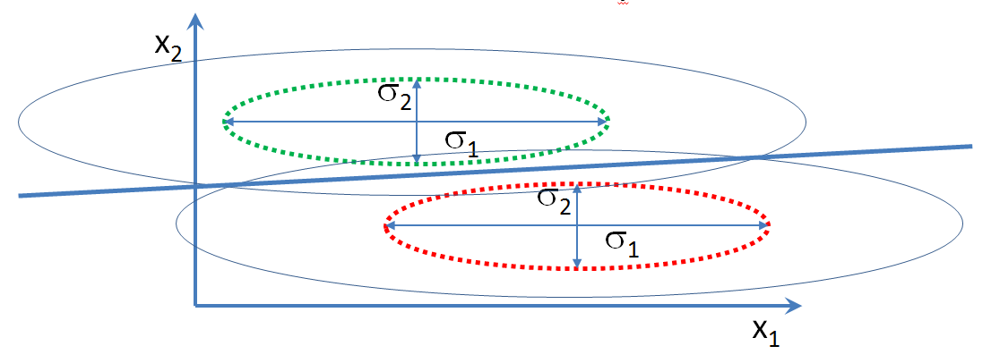
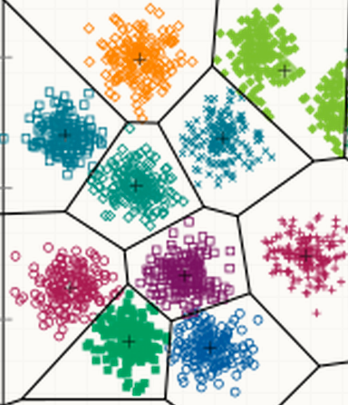
Extensions
Different σ for the 2 classes:
σ^{[0]} and σ^{[1]}.
Different σ_{i} for all coordinates
(but same for both classes).
f(x) = ∑_{i} [(μ_{i}^{[1]} – μ_{i}^{[0]})/σ_{i}²] x_{i} + b
Different σ_{i} ^{[0]} and σ_{i} ^{[1]}.
Multiclass.

Slide 32
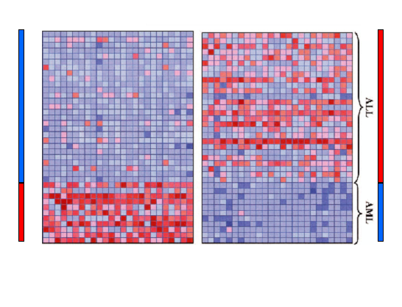
Gaussian classifier, T-test, and univariate feature selection
d
-1
+1
N
μ_{i}^{[0]}
-
μ_{i}^{[1]}
+1
-1
{-y_{i}}
{y_{i}}
Golub et al, Science Vol 286:15 Oct. 1999
μ_{i}^{[1]} - μ_{i}^{[0]}
-1
σ_{i} ≅ ½ (σ_{i}^{[0]} + σ_{i}^{[1]} )
w_{i} =
σ_{i}²
Rank features according to “signal-to-noise” ratio:
S2N = | σ_{i} w_{i} | ≅ | corrcoef | ∼ | x • y |
For “balanced classes and after “standardization” x ←(x-μ_{x})/σ_{x}
σ_{i}^{[0]}
σ_{i}^{[1]}

Slide 33
Link with “Naïve Bayes”
Naïve Bayes classifies according to argmax_{y} P(Y=y|X=x) making independence assumptions between variables.
Independence between variables given Y means:
P(X₁, X₂, … X_{N}|Y) = Π_{i=1:N} P(X_{i}|Y)
So Naïve Bayes means classify according to:
argmax_{y} Π_{i=1:N} P(X_{i}=x_{i}|Y=y) P(Y=y)
The Gaussian classifier also makes independence assumptions:
P(X|Y) ~ exp(-ǁx-μǁ²/2σ²) = exp(- ∑_{i=1:N} (x_{i}-μ_{i})²/2σ²)
= Π_{i=1:N} exp(-(x_{i}-μ)²/2σ²) ~ Π_{i=1:N} P(X_{i}|Y)

Slide 34
“Naïve Bayes” for binary inputs
ŷ = argmax_{y} Π_{i=1:N} P(X_{i}=x_{i}|Y=y) P(Y=y)
Binary variables x_{i} ∈{0, 1}, y∈{-1, 1}
Each factor P(X_{i}=x_{i}|Y=y) and P(Y=y) can be estimated from frequency counts:
P(X_{i} =1|Y=1) = f_{11i} P(X_{i} =0|Y=1) = f_{01i} P(Y=1) = f₁
P(X_{i} =1|Y=-1) = f_{10i} P(X_{i} =0|Y=-1) = f_{00i} P(Y=-1) = f₀
f(x) = log(f₁/ f₀) + Σ_{i=1:N} x_{i} log P(X_{i}=1|Y=1) + (1-x_{i}) log P(X_{i}=0|Y=1)
- x_{i} log P(X_{i}=1|Y=-1) - (1-x_{i}) log P(X_{i}=0|Y=-1)
f(x)= Σ_{i=1:N} w_{i} x_{i} + b = w • x+ b
w_{i} = log (f_{11i}/f_{10i}) - log (f_{01i}/f_{00i})
b = Σ_{i=1:N} log (f_{01i}/f_{00i}) + log(f₁/ f₀)
Extends to categorical variables (instead of binary).

Slide 35
Generative models
You are here
Mixture models
LDA
Gaussian
processes
Naïve Bayes

Slide 36
Summary
The Gaussian classifier is a “generative model” modeling P(X=x|Y=y) ~ exp(-ǁx-μ^{[y]}ǁ²/2σ²).
Using Baye’s rule,
P(Y=y|X=x) ~ P(Y=y) P(X=x|Y=y)
one can make “Bayes optimal”-style decisions according to max_{y} P(Y=y|X=x).
The main assumption is the “naïve Bayes” assumption of statistical independence of the input variables:
P(X=x|Y=y)= Π_{i=1:N} P(X_{i}=x_{i}|Y=y)
If the 2 classes have the same σ, the Gaussian classifier is a linear discriminant, aka the centroid method, aka Hebb’s rule with target values 1/N₁ and -1/N₀.
“Naïve Bayes” is NOT “Bayes optimal” (because of independence assumptions and the estimation of parameters from a finite training set, but it is very useful).

Slide 37
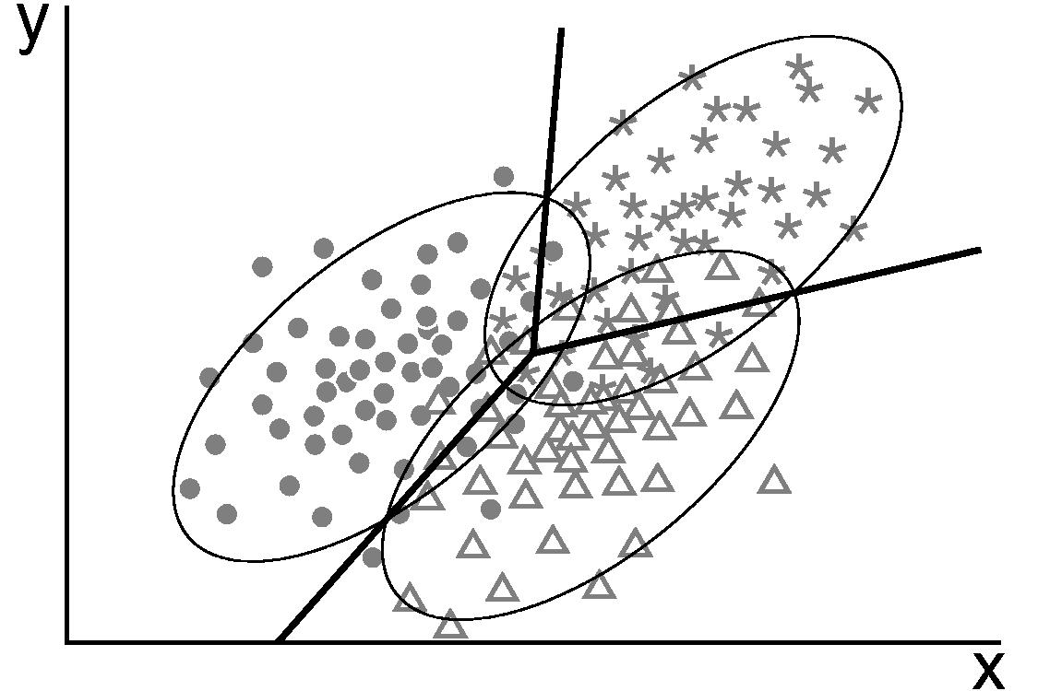
Come to my office hours… Wed 2:30-4:30 Soda 329
Next time: LDA

